Slide 1

MESSFINDER
Also Known as Mess Finder A single platform for finding and listing rooms and PGs.
TEAM MEMBERS
Aakash Shit
Moumita Dhabal
Priti Banerjee
Puja Chowdhury
Reshmi Singh
Subhadip Garai
Souvik Bhattacharya
Sujoy Bhakat
Susanta Mandi
INSTITUTIONS
Department of Computer Science
Bankura Sammilani College

Slide 2

Know About MessFinder
3.
Why we built this app?
“By considering the high demand of rental rooms, in the growing generation, it is very difficult to find rooms too easily and quickly, but with our one stop solution it can helps you to find rooms.”
2.
Who is it for?
“Is it for specifically students and working professionals, who have to switch to another location for study and working purpose, it helps them find rooms in advance before relocating.”
1.
What is Mess Finder?
“Mess Finder is a web application which helps students and working professionals find affordable rooms for rent.”
MESSFINDER
Also Known as Mess Finder A single platform for finding and listing rooms and PGs.
TEAM MEMBERS
Aakash Shit
Moumita Dhabal
Priti Banerjee
Puja Chowdhury
Reshmi Singh
Subhadip Garai
Souvik Bhattacharya
Sujoy Bhakat
Susanta Mandi
INSTITUTIONS
Department of Computer Science
Bankura Sammilani College

Slide 3
Know About MessFinder
3.
Why we built this app?
“By considering the high demand of rental rooms, in the growing generation, it is very difficult to find rooms too easily and quickly, but with our one stop solution it can helps you to find rooms.”
2.
Who is it for?
“Is it for specifically students and working professionals, who have to switch to another location for study and working purpose, it helps them find rooms in advance before relocating.”
1.
What is Mess Finder?
“Mess Finder is a web application which helps students and working professionals find affordable rooms for rent.”
MESSFINDER
Also Known as Mess Finder A single platform for finding and listing rooms and PGs.
TEAM MEMBERS
Aakash Shit
Moumita Dhabal
Priti Banerjee
Puja Chowdhury
Reshmi Singh
Subhadip Garai
Souvik Bhattacharya
Sujoy Bhakat
Susanta Mandi
INSTITUTIONS
Department of Computer Science
Bankura Sammilani College

Slide 4
Know About MessFinder
1.
What is Mess Finder?
“Mess Finder is a web application which helps students and working professionals find affordable rooms for rent.”
3.
Why we built this app?
“By considering the high demand of rental rooms, in the growing generation, it is very difficult to find rooms too easily and quickly, but with our one stop solution it can helps you to find rooms.”
2.
Who is it for?
“Is it for specifically students and working professionals, who have to switch to another location for study and working purpose, it helps them find rooms in advance before relocating.”
MESSFINDER

Slide 5


Problems facing!
Know About MessFinder
1
Difficult to find rooms!
“To find room, people have to check many different places like, Facebook, Google Map, posters, or ask others to find a room. As everything is unorganized.”
3
Very hard and time-consuming!
“People have to find room, people have to check many different places like, Facebook, Google Map, posters, or ask others o find a room. As everything is unorganized.”
2
Lack of trusted sources.
“it is very difficult to verify owner credibility and trusted room, as many scamming sites are there who fool users and steal money from them.”
1.
What is Mess Finder?
“Mess Finder is a web application which helps students and working professionals find affordable rooms for rent.”
2.
Who is it for?
“Is it for specifically students and working professionals, who have to switch to another location for study and working purpose, it helps them find rooms in advance before relocating.”
3.
Why we built this app?
“By considering the high demand of rental rooms, in the growing generation, it is very difficult to find rooms too easily and quickly, but with our one stop solution it can helps you to find rooms.”

Slide 6


Know About MessFinder
Problems facing!
1
Difficult to find rooms!
“To find room, people have to check many different places like, Facebook, Google Map, posters, or ask others to find a room. As everything is unorganized.”
3
Very hard and time-consuming!
“People have to find room, people have to check many different places like, Facebook, Google Map, posters, or ask others o find a room. As everything is unorganized.”
2
Lack of trusted sources.
“it is very difficult to verify owner credibility and trusted room, as many scamming sites are there who fool users and steal money from them.”
2.
Who is it for?
“Is it for specifically students and working professionals, who have to switch to another location for study and working purpose, it helps them find rooms in advance before relocating.”
3.
Why we built this app?
“By considering the high demand of rental rooms, in the growing generation, it is very difficult to find rooms too easily and quickly, but with our one stop solution it can helps you to find rooms.”

Slide 7


Problems facing!
2
Lack of trusted sources.
“it is very difficult to verify owner credibility and trusted room, as many scamming sites are there who fool users and steal money from them.”
3
Very hard and time-consuming!
“People have to find room, people have to check many different places like, Facebook, Google Map, posters, or ask others o find a room. As everything is unorganized.”
1
Difficult to find rooms!
“To find room, people have to check many different places like, Facebook, Google Map, posters, or ask others to find a room. As everything is unorganized.”

Slide 8




Our Goals
Problems facing!
3
Very hard and time-consuming!
“People have to find room, people have to check many different places like, Facebook, Google Map, posters, or ask others o find a room. As everything is unorganized.”
Connect room seekers with owners
2
Lack of trusted sources.
“it is very difficult to verify owner credibility and trusted room, as many scamming sites are there who fool users and steal money from them.”
1
Difficult to find rooms!
“To find room, people have to check many different places like, Facebook, Google Map, posters, or ask others to find a room. As everything is unorganized.”
Easy-to-use, secure platform
Digitize rental experience

Slide 9


Our Goals
Problems facing!
3
Very hard and time-consuming!
“People have to find room, people have to check many different places like, Facebook, Google Map, posters, or ask others o find a room. As everything is unorganized.”
Connect room seekers with owners
2
Lack of trusted sources.
“it is very difficult to verify owner credibility and trusted room, as many scamming sites are there who fool users and steal money from them.”
Easy-to-use, secure platform
Digitize rental experience

Slide 10

Our Goals
Connect room seekers with owners
Easy-to-use, secure platform
Digitize rental experience

Slide 11

Our Goals
Connect room seekers with owners
Easy-to-use, secure platform
Digitize rental experience
How MessFinder Helps Society
Benefits students and job seekers
Supports local PG owners
Encourages digital inclusion

Slide 12

Our Goals
Connect room seekers with owners
Easy-to-use, secure platform
Digitize rental experience
How MessFinder Helps Society
Benefits students and job seekers
Supports local PG owners
Encourages digital inclusion

Slide 13

How MessFinder Helps Society
Benefits students and job seekers
Supports local PG owners
Encourages digital inclusion

Slide 14

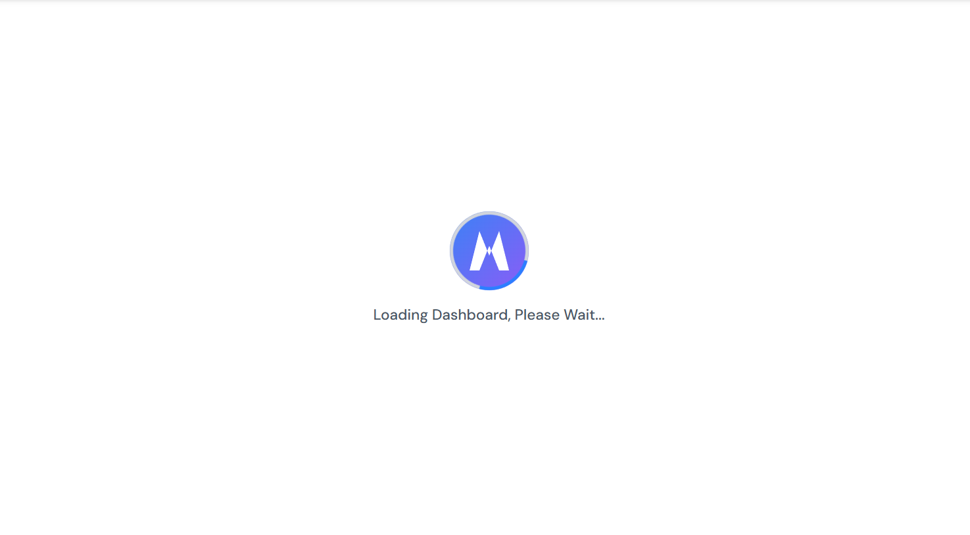
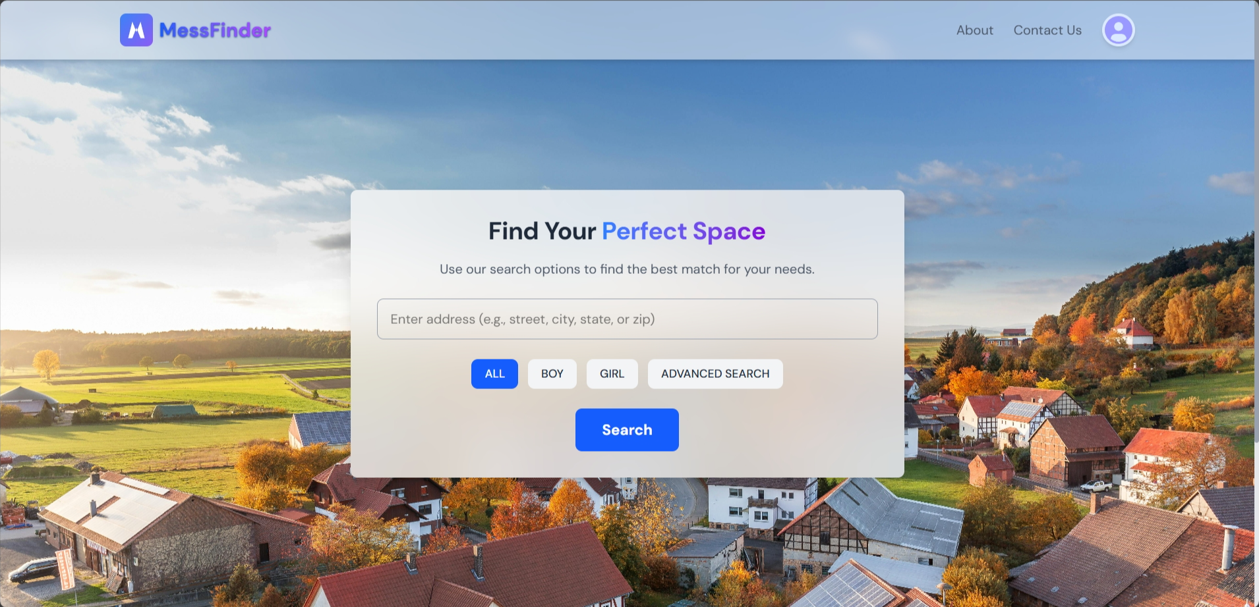
How MessFinder Helps Society
Benefits students and job seekers
Supports local PG owners
Encourages digital inclusion
Main Features
Users can search and filter result.
Owners can post rooms with images.
Real-time chat and easy booking.

Slide 15
How MessFinder Helps Society
Benefits students and job seekers
Supports local PG owners
Encourages digital inclusion
Main Features
Users can search and filter result.
Owners can post rooms with images.
Real-time chat and easy booking.

Slide 16
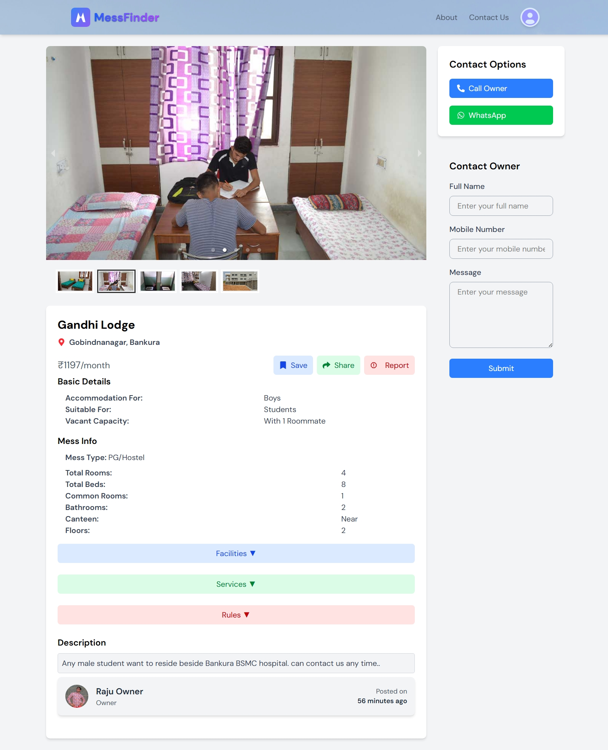
Main Features
Users can search and filter result.
Owners can post rooms with images.
Real-time chat and easy booking.

Slide 17
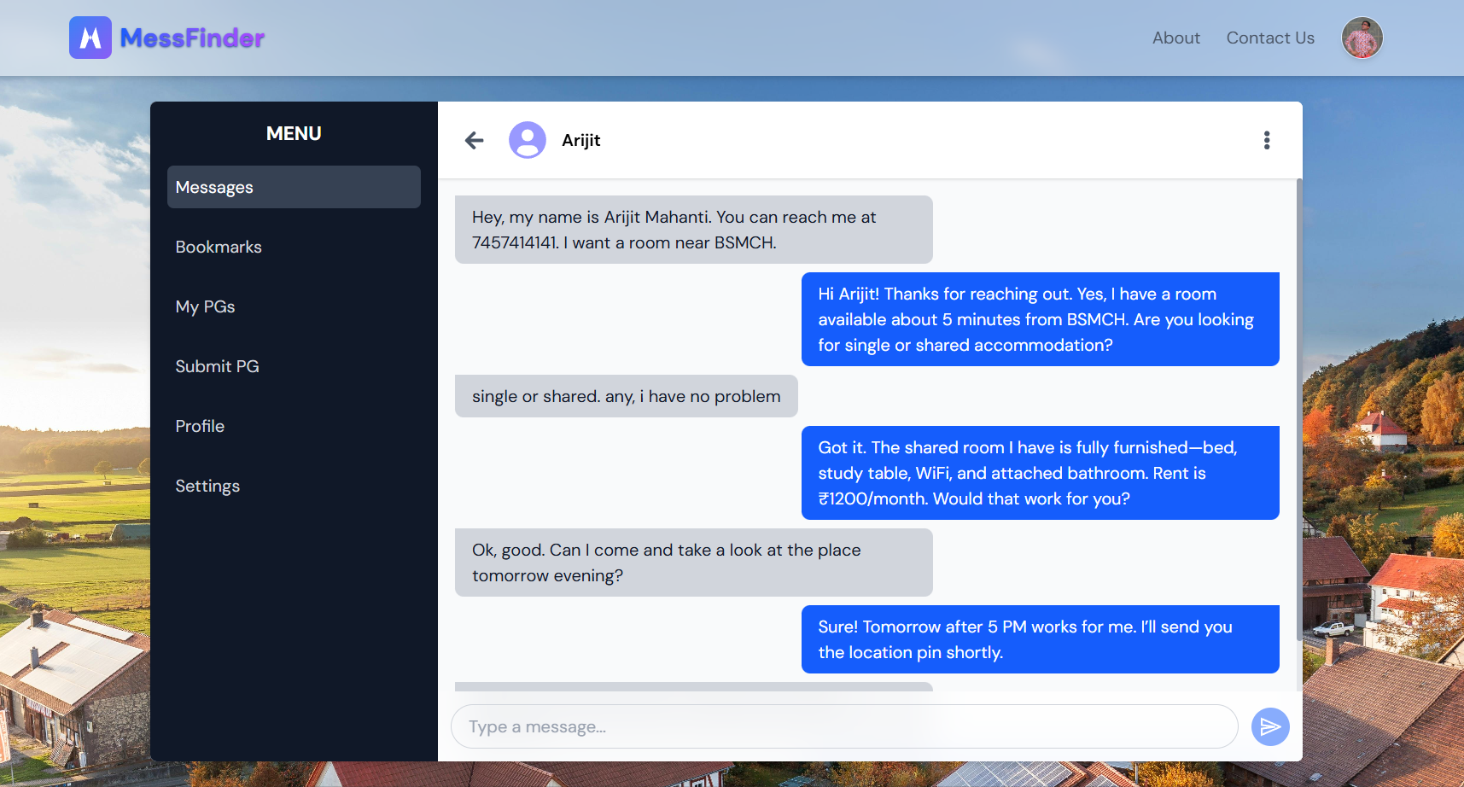
Main Features
Users can search and filter result.
Owners can post rooms with images.
Real-time chat and easy booking.

Slide 18
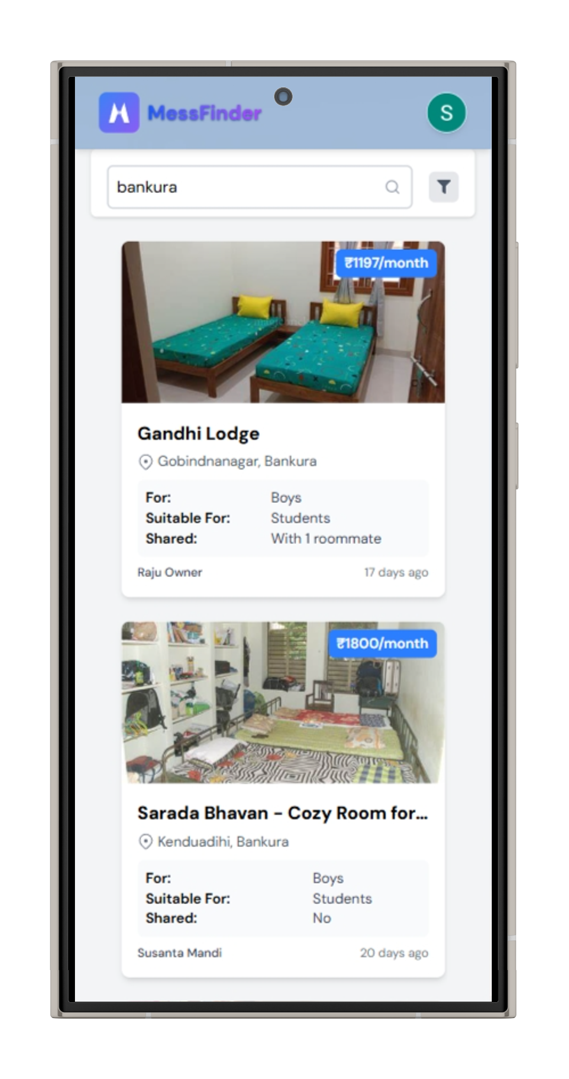





Is MessFinder Feasible?
Anyone with a smartphone can use it.
Built on simple, scalable tools.
Low-cost setup, deploy and host using free tools.

Slide 19




Is MessFinder Feasible?
Anyone with a smartphone can use it.
Built on simple, scalable tools.
Low-cost setup, deploy and host using free tools.

Slide 20
Is MessFinder Feasible?
Anyone with a smartphone can use it.
Built on simple, scalable tools.
Low-cost setup, deploy and host using free tools.

Slide 21
How It’s Built
DEVELOPMENT PROCESS
Requirement Gathering And Feasibility Study
1
2
System Analysis and Planning

Slide 22
Designing and Coding
3
4
Testing and Fixing
Deploying and Hosting
5
6
Maintenance - Fix and Update

Slide 23
Why this Tech Stack
React
Tailwind
Firebase
Reusable Components
Efficient Rendering
React Router
State and Hooks
And many more
Fast and Flexible
Mobile-first, responsive design
Clean and maintainable styling
Firebase Authentication
Real-Time, scalable NoSQL database
Cloud Storage for images/files

Slide 24
Why this Tech Stack
React
Tailwind
Firebase
Reusable Components
Efficient Rendering
React Router
State and Hooks
And many more
Fast and Flexible
Mobile-first, responsive design
Clean and maintainable styling
Firebase Authentication
Real-Time, scalable NoSQL database
Cloud Storage for images/files

Slide 25
Why this Tech Stack
React
Tailwind
Firebase
Reusable Components
Efficient Rendering
React Router
State and Hooks
And many more
Fast and Flexible
Mobile-first, responsive design
Clean and maintainable styling
Firebase Authentication
Real-Time, scalable NoSQL database
Cloud Storage for images/files

Slide 26


Who Can Do What
USER ROLES
USER
FLOW
OWNER
Enter Search Keyword, (e.g., Location, Name) and click on Search)
1
HomePage

Slide 27
USER
FLOW
Enter Search Keyword, (e.g., Location, Name) and click on Search)
1
HomePage

Slide 28
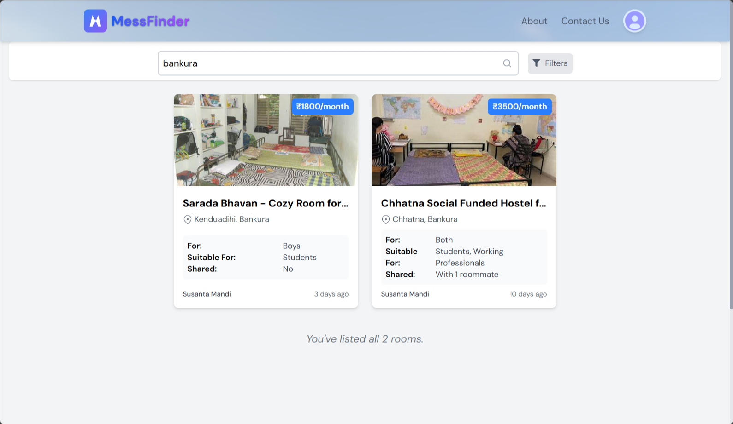
2
Enter Search Keyword, (e.g., Location, Name) and click on Search)
Search Result

Slide 29
Click on Contact Options, to Contact, or Send a message instead.
3
Room View

Slide 30
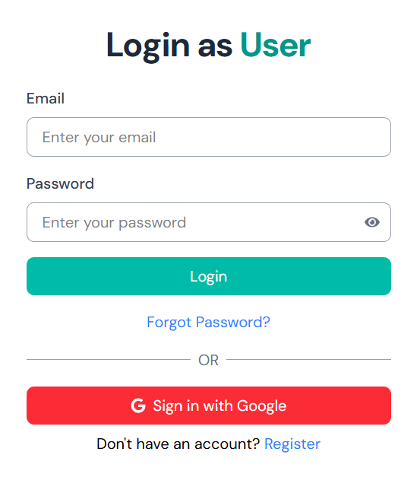
4
Login as user, to chat with owner, and save rooms, and access other features.
Login

Slide 31
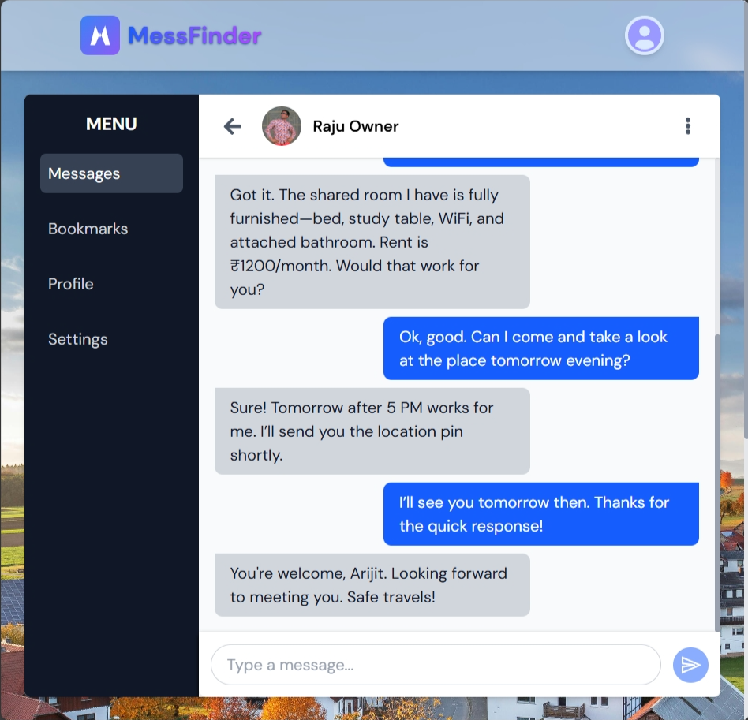
Message with owner, and fix date for visit, and fix rent.
5
Message

Slide 32
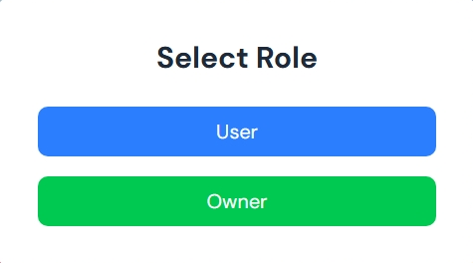
OWNER
FLOW
Select Owner as Role, When Creating new account.
1
Select Role

Slide 33
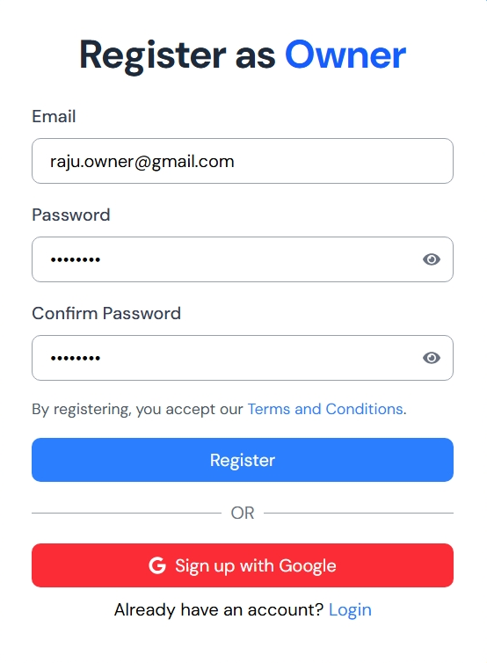
2
Login or Register as owner, to access features like creating room, and messaging with users, etc.
Login/Register

Slide 34
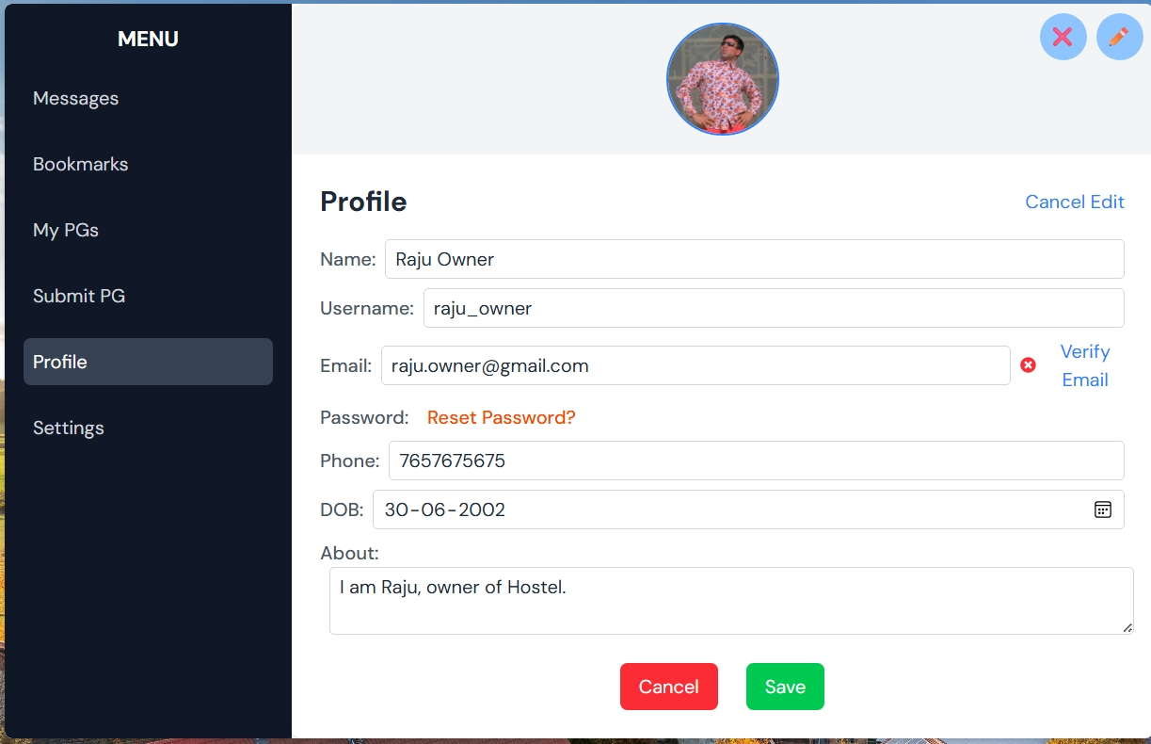
Update Profile details, like mobile, email, to submit details and accept calls, and messages.
3
Edit Profile

Slide 35
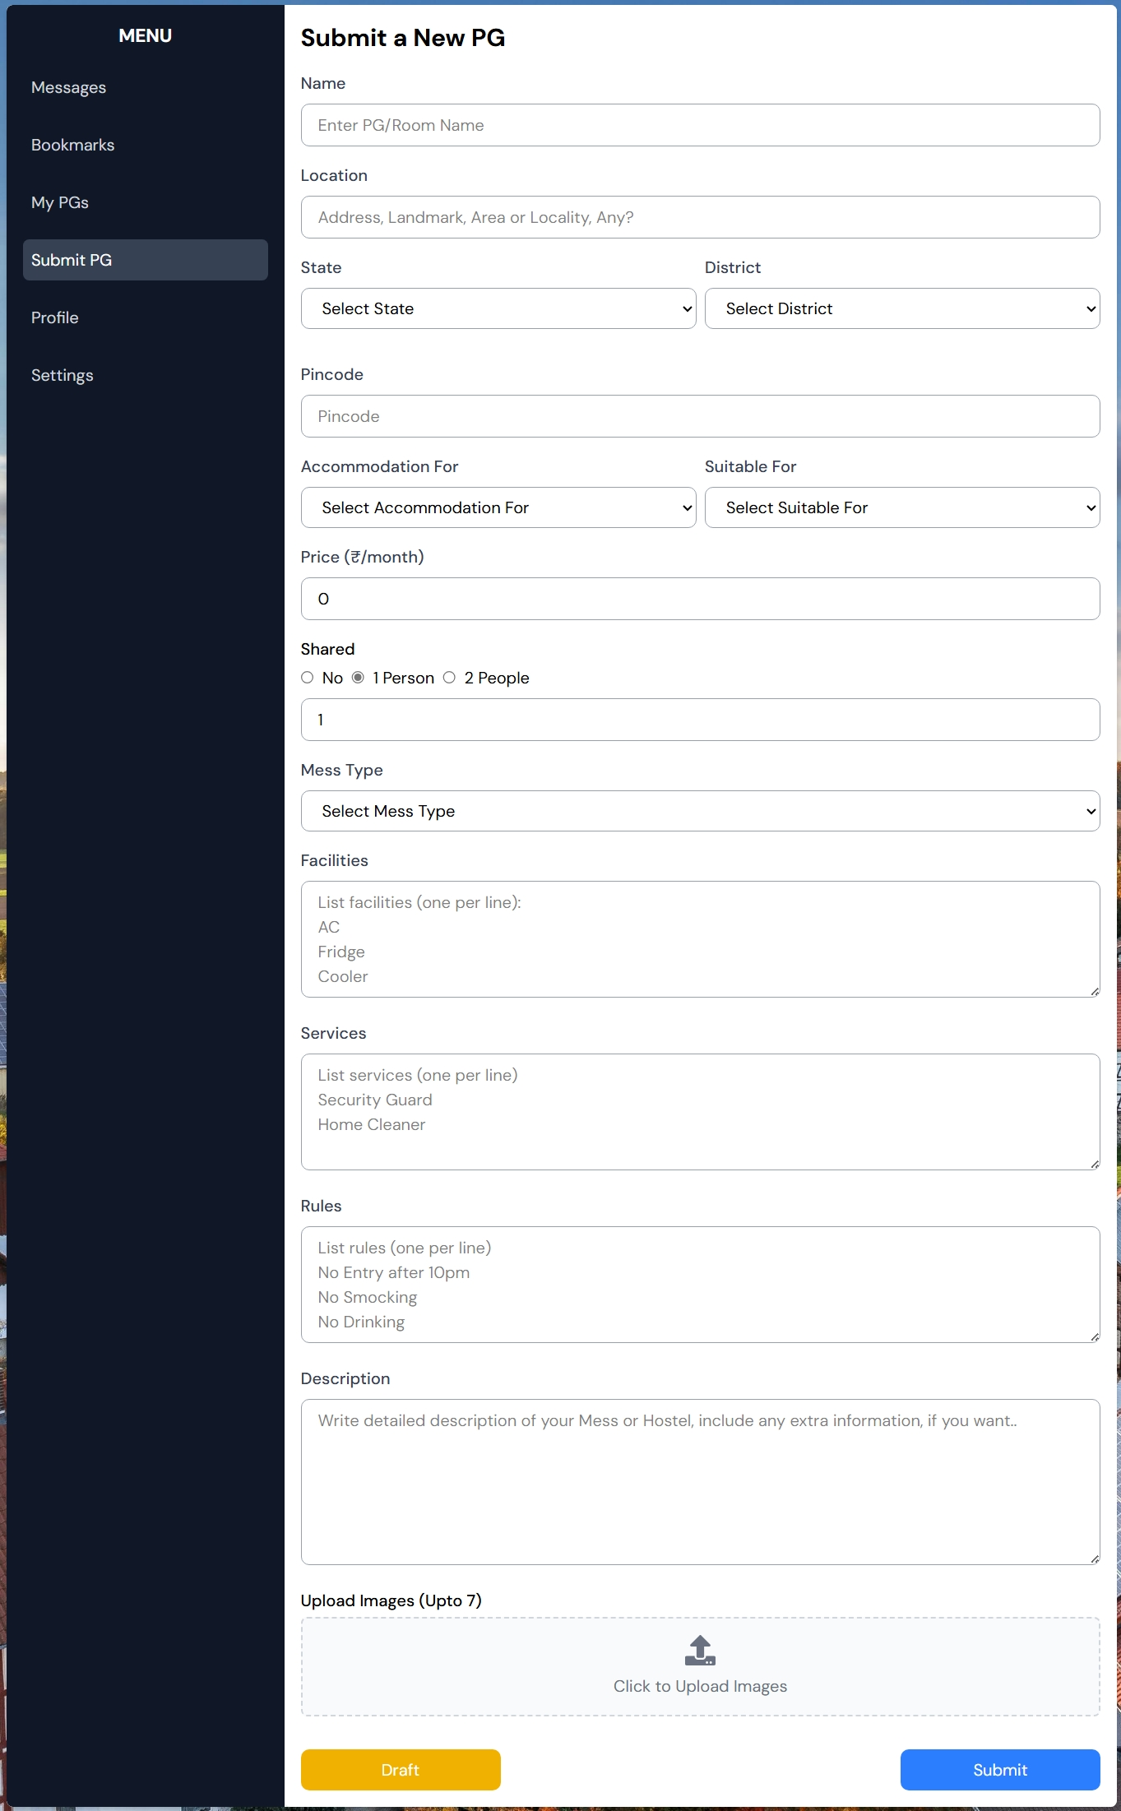
4
Submit PG
Submit Your, PG, Room Details to with images and location, to list on search.

Slide 36
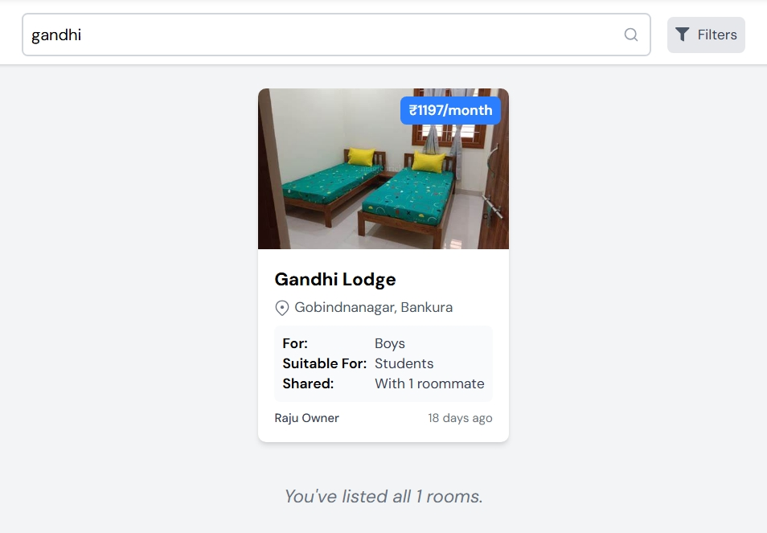

Keeping Data Safe (Security)
Finally Show Your PG list, or in search result.
3
Published
Secure login
Secure chat
Using hash and encryption
Role-based access control
Using HTTPS
Login Securely, using Firebase, use hash to store passwords.

Slide 37


Finally Show Your PG list, or in search result.
3
Published
Keeping Data Safe (Security)
Secure login
Secure chat
Using hash and encryption
Login Securely, using Firebase, use hash to store passwords.
Role-based access control
Using HTTPS
Secure and Realtime chat, with SSL Encryption.

Slide 38

Keeping Data Safe (Security)
Secure login
Secure chat
Using hash and encryption
Secure and Realtime chat, with SSL Encryption.
Role-based access control
Using HTTPS
Login Securely, using Firebase, use hash to store passwords.
Passwords and Users Information are saved and transferred securely with advance encryption methods.

Slide 39

Keeping Data Safe (Security)
Secure login
Secure chat
Passwords and Users Information are saved and transferred securely with advance encryption methods.
Using hash and encryption
Role-based access control
Using HTTPS
Secure and Realtime chat, with SSL Encryption.
User can access data that is required, and can’t access others data. It prevents misuse of privilege.

Slide 40

Keeping Data Safe (Security)
Secure login
Secure chat
Using hash and encryption
User can access data that is required, and can’t access others data. It prevents misuse of privilege.
Role-based access control
Using HTTPS
Passwords and Users Information are saved and transferred securely with advance encryption methods.
HTTPS uses SSL/TLS to encrypt communication between the browser and the server, keeping data secure and protected from interception.

Slide 41

What’s Next? (Future Plans)
Keeping Data Safe (Security)
Secure login
Secure chat
HTTPS uses SSL/TLS to encrypt communication between the browser and the server, keeping data secure and protected from interception.
Using hash and encryption
Role-based access control
Using HTTPS
User can access data that is required, and can’t access others data. It prevents misuse of privilege.
Add payment options.
Push notifications.
Map based Search.
Accessibility Controls
User review/rating system

Slide 42

Keeping Data Safe (Security)
What’s Next? (Future Plans)
Add payment options.
Push notifications.
Secure login
Map based Search.
Secure chat
HTTPS uses SSL/TLS to encrypt communication between the browser and the server, keeping data secure and protected from interception.
Using hash and encryption
Accessibility Controls
Role-based access control
Using HTTPS
User review/rating system

Slide 43


What’s Next? (Future Plans)
Add payment options.
Push notifications.
Map based Search.
Accessibility Controls
User review/rating system

Slide 44

What’s Next? (Future Plans)
Add payment options.
Push notifications.
Map based Search.
Accessibility Controls
User review/rating system

Slide 45

What’s Next? (Future Plans)
Add payment options.
Push notifications.
Map based Search.
Accessibility Controls
User review/rating system

Slide 46
What’s Next? (Future Plans)
Add payment options.
Push notifications.
Map based Search.
Accessibility Controls
User review/rating system
Y

Slide 47
Reference
Icons/illustrations/Image:
https://svgrepo.com
https://unsplash.com/
THANK YOU
Y

Slide 48
What’s Next? (Future Plans)
Add payment and map features.
Push notifications.
Map based Search.
Accessibility Controls
User review/rating system
THANK YOU

